Slide 1

Olympic Data Analyzer
Report of Python Project
Programming in Python (CAP 776)
Submitted By:
Vishal Alpuria 12325331
Pranav Sharma 12324310
Rahul Kumar Gupta 12326327
Submitted To:
Mr. Girish Kumar

Slide 2

Olympic Data Analyzer: A Python Project Report
This report presents a detailed analysis of the "Olympic Data Analyzer" project, a Python program designed to explore and analyze data from the Olympic Games. It showcases the project's objectives, functionality, implementation, and key features.

Slide 3
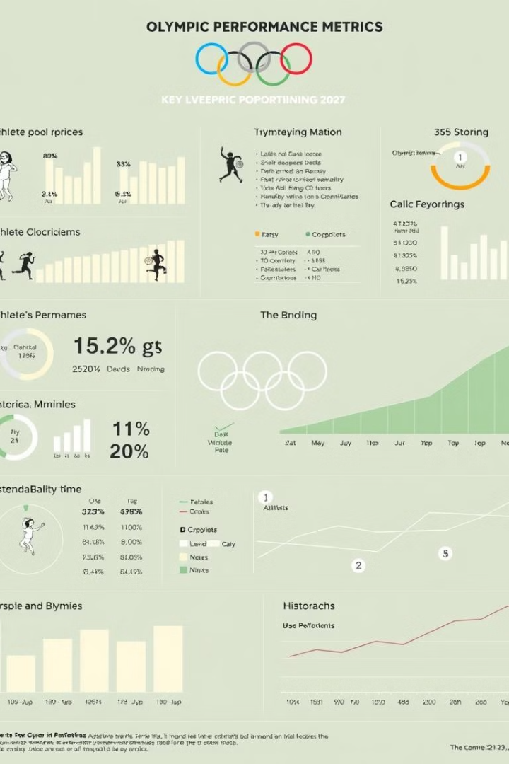
Project Objectives
1
Data Analysis
To enable users to analyze Olympic data, focusing on key performance indicators.
2
Interactive Exploration
To provide an interactive menu-driven interface for users to query and explore the dataset.
3
Performance Insights
To provide insights into athlete performance, country-wise contributions, and historical trends.
4
Data Visualization
To visualize the analyzed data effectively, facilitating a deeper understanding of the trends.

Slide 4
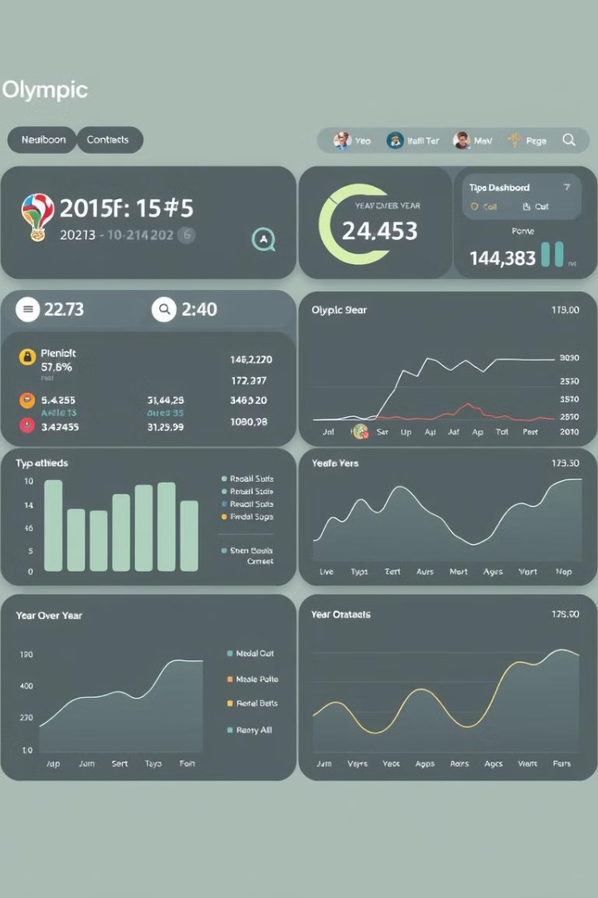
System Functionality
Athlete Counts
Provides total athlete count and athlete count per country.
Medal Statistics
Calculates medal counts by country, team, and session.
Average Athlete Attributes
Calculates average age, height, and weight of athletes by sport.
Year-Wise Analysis
Displays year-wise medal distribution, allowing users to track performance trends.

Slide 5
Technology Stack
Programming Language
Data Structure
Libraries Used
Python was chosen for its readability, extensive libraries, and suitability for data analysis.
The data was stored in a dictionary format, chosen for its flexibility and ability to represent complex data relationships.
No external libraries were required for this project. Python's standard libraries like input for user input and data structures like lists and dictionaries were used for implementation.

Slide 6
Key Features and Implementation
Total Number of Athletes
1
The system counts the total number of unique athletes by checking their unique IDs.
2
Athletes Per Country
This feature computes the number of athletes representing each country and allows the user to view either a specific country or a summary for all countries.
Medal Counts by Country
3
Users can retrieve the number of medals won by athletes from each country, categorized by gold, silver, and bronze.
4
Average Age of Athletes by Sport
The system calculates the average age of athletes participating in different sports.

Slide 7
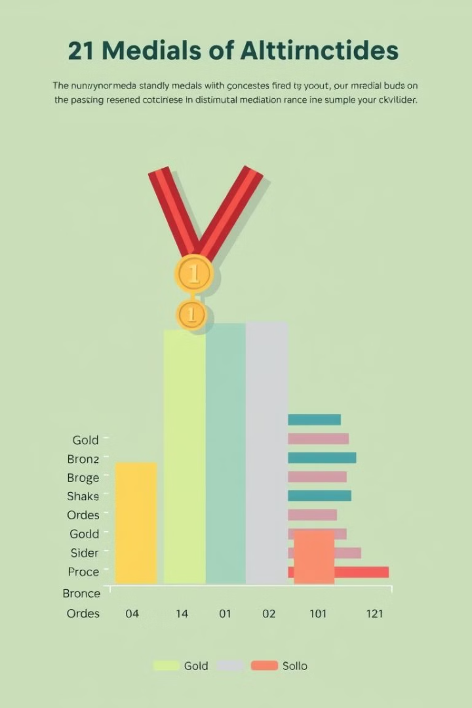
Key Features and Implementation (continued)
1
Medal Distribution
Users can view the overall distribution of medals as well as the country with the highest count of gold, silver, and bronze medals.
2
Medals Won by Team
This function tracks medals won by each team, broken down by medal type (gold, silver, bronze).
3
Medals by Year
Users can see the number of medals awarded in each year for each type of medal.
4
Average Height and Weight of Athletes
The program calculates the average height and weight of athletes, providing insight into the physical attributes of Olympic participants.

Slide 8
Key Features and Implementation (continued)
1
Number of Events by Sport
This feature counts the total number of events for each sport in the dataset.
2
Medal Counts by Season
Users can explore how medals are distributed across summer and winter Olympic games.
3
Height and Weight Statistics
This function computes basic statistics (minimum, maximum, mean) for athletes' height and weight, giving an overview of the physical trends over the years.
4
Year-Wise Medal Distribution
The year-wise distribution of medals is displayed for each country, helping users analyze performance trends over time.

Slide 9

Conclusion
The Olympic Data Analyzer project provides a valuable tool for analyzing Olympic data. Its user-friendly interface allows for easy exploration and extraction of insightful information about athlete performance, medal distribution, and historical trends. With potential for future expansion and integration with real Olympic datasets, this project could become a powerful resource for sports enthusiasts and researchers.

